Slide 1

Introduction to Clean Development Mechanism(CDM) and Carbon Trading

Slide 2
Contents
Kyoto Protocol and CDM Context
Overview of CDM
CDM Concept
CDM Objectives
Types of CDM Projects
Opportunities of CDM
Carbon Trading
Carbon Sellers and Buyers
In Context of Nepal
References

Slide 3
Kyoto Protocol and CDM Context
Kyoto Protocol drafted at Kyoto, in 1992 to combat global climate change .
Joint implementation (Developed Countries)
Clean Development Mechanism (Developing Countries)
International Emission Trading (Emission Credit through special market)
Committed industrialized countries to legally binding GHG reduction targets during the period 2008-2012.
Most countries have to reduce GHG emissions on ave. 5% below their 1990 emission levels
results in a global target of ‘carbon’ reduction.
Reducing emissions in Developing Countries is eligible – known as CDM.

Slide 4
Overview of CDM
CDM – Clean Development Mechanism
A mechanism which is based on understanding and cooperation among the nations for adopting a new outlook for economic activities aiming at protecting the world eco-system.
The Certified Emission Reductions (CERs) are a unit of carbon that is reduced or seized.
Industrialized Nations can submit their CERs to meet their target in 2008-2012.
there is a worldwide demand for projects and activities for ‘carbon’ reduction or fixation
Many of these projects will be in Developing Countries.

Slide 5
CDM Concept
Developing Country
Many opportunities for projects that reduce emissions eg
Forestry planting
Renewable electricity
Energy efficiency
Clean transport
Biomass energy
Project Produces CERs
$
Developed Country
Govt and companies want to reduce GHG emissions
Invest in their own country
Invest in a project in Developing Country
Investment
CERs

Slide 6
CDM Objectives
To assist developing countries in achieving sustainable development & in contributing to ultimate objectives of United Nations Framework Convention on Climate Change (UNFCCC )
To assist developing countries in achieving compliance with their qualified emission limit & reduction commitments.
(United Nation Framework Convention on Climate Change(UNFCCC) )

Slide 7
Types of CDM Projects
Energy efficiency
End use improvements
Supply-side improvements
Renewable energy
Methane reduction eg. landfill gas capture
Fuel switching
Agriculture (CH₄ and N₂0)
Industrial processes
Sequestration/sinks – only afforestation and reforestation

Slide 8
CDM Project Examples
End-use energy efficiency | High efficient lighting; efficient cook stoves; vehicle efficiency
Supply-side energy efficiency | High efficiency turbine replacement; combine cycle
Renewable energy | Biomass; Solar; Wind; Hydro
Fuel switching | Gas conversion Biofuels replace fossil fuels
Forestry | Afforestation; Reforestation Community forestry
Agriculture | Intermittent rice field irrigation

Slide 9
Opportunities of CDM
CDM encourages developed countries to undertake GHG reduction projects in developing countries.
Increased investment flows
Attract capital for less carbon-intensive projects
Technology transfer
Assist in development priorities and sustainable development goals
Create new industries in environmentally sustainable technologies
Poverty alleviation through income and employment
Assist in improving current and future environment (including air quality

Slide 10
Carbon Trading
Another idea that came about in response to Kyoto Protocol.
Carbon would be given an economic value, allowing people, companies or nations to trade it.
If a nation bought carbon, it would be buying the rights to burn it, and a nation selling carbon would be giving up its rights to burn it.
Industrialized nations finds reducing emissions a daunting task.
They could buy the emission rights from another nation whose industries do not produce as much of these gases.

Slide 11
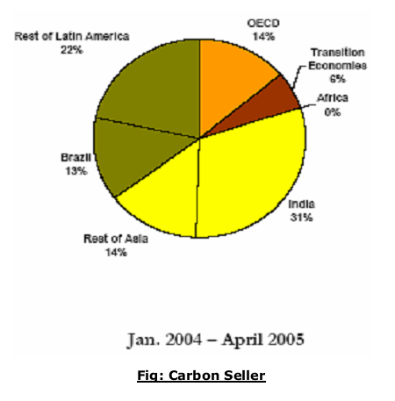
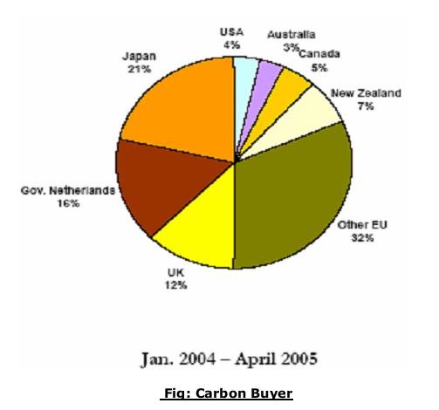
Carbon Sellers and Buyers source:- (Sada Rajesh, 2007)

Slide 12
Benefits from Carbon Trading
the reduction in overall cost of meeting emission reduction targets.
the progressively improved definition of a "price" for carbon, particularly as the market becomes more liquid and active, and assuming that all carbon certificate products are fungible, meaning that they are equivalent ways of addressing emission reduction;
the opportunity to generate income from activities that previously attracted no additional revenue, such as investment in emission reduction, renewable energy generation, greenhouse friendly fuels and carbon sequestration;
the ability to use revenue from carbon sequestration to help fund additional planting of trees and other vegetation, for benefits such as salinity amelioration, biodiversity enhancement, conversion to greenhouse gas friendly fuels and energy, and employment and wealth creation in rural areas.

Slide 13
In Context of Nepal
Nepal accepted the Kyoto Protocol in 2005, 16th September.
The Government of Nepal (GoN) decided on 22nd December 2005 that the then Ministry of Population and Environment (now Ministry of Science, Technology and Environment (MoSTE)) would function as Designated National Authority (DNA) to CDM projects related to the Kyoto Protocol.(Ministry of science technology and Environment,2013)

Slide 14
In Context of Nepal (cont…)
Nepal signed onto "a carbon emissions reduction" agreement with the World Bank whereby it will trade surplus carbon for biogas plants.
The Nepal Biogas Project (NBP) became the first project for carbon trading under the Clean Development Mechanism of the Kyoto Protocol on climate change.
NBP can sell to developed countries the volume equivalent of carbon emissions it contains and prevents from being released into the environment.
Nepal will receive yearly Rs.40.34 million ($568,000) from selling carbon.
Source:-(International global watch, 2006)

Slide 15
References
Edition, S. (n.d.). The Clean Development Mechanism (CDM), (Cdm).
Government of Nepal Ministry of Science , Technology and Environment Designated National Authority for Clean Development Mechanism of The Kyoto Protocol April 2013. (2013), (April).
Promise, T., & Premise, T. (n.d.). What is Clean Development Mechanism ?
Sada, R. (2007). Carbon trading.
https://en.wikipedia.org/wiki/Clean_Development_Mechanism
http://ippan.org.np/23june2006.html

Slide 16
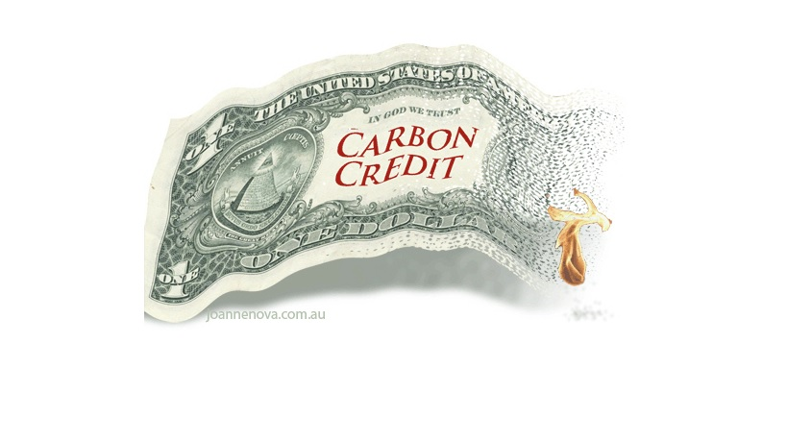
THANK YOU

